Slide 1
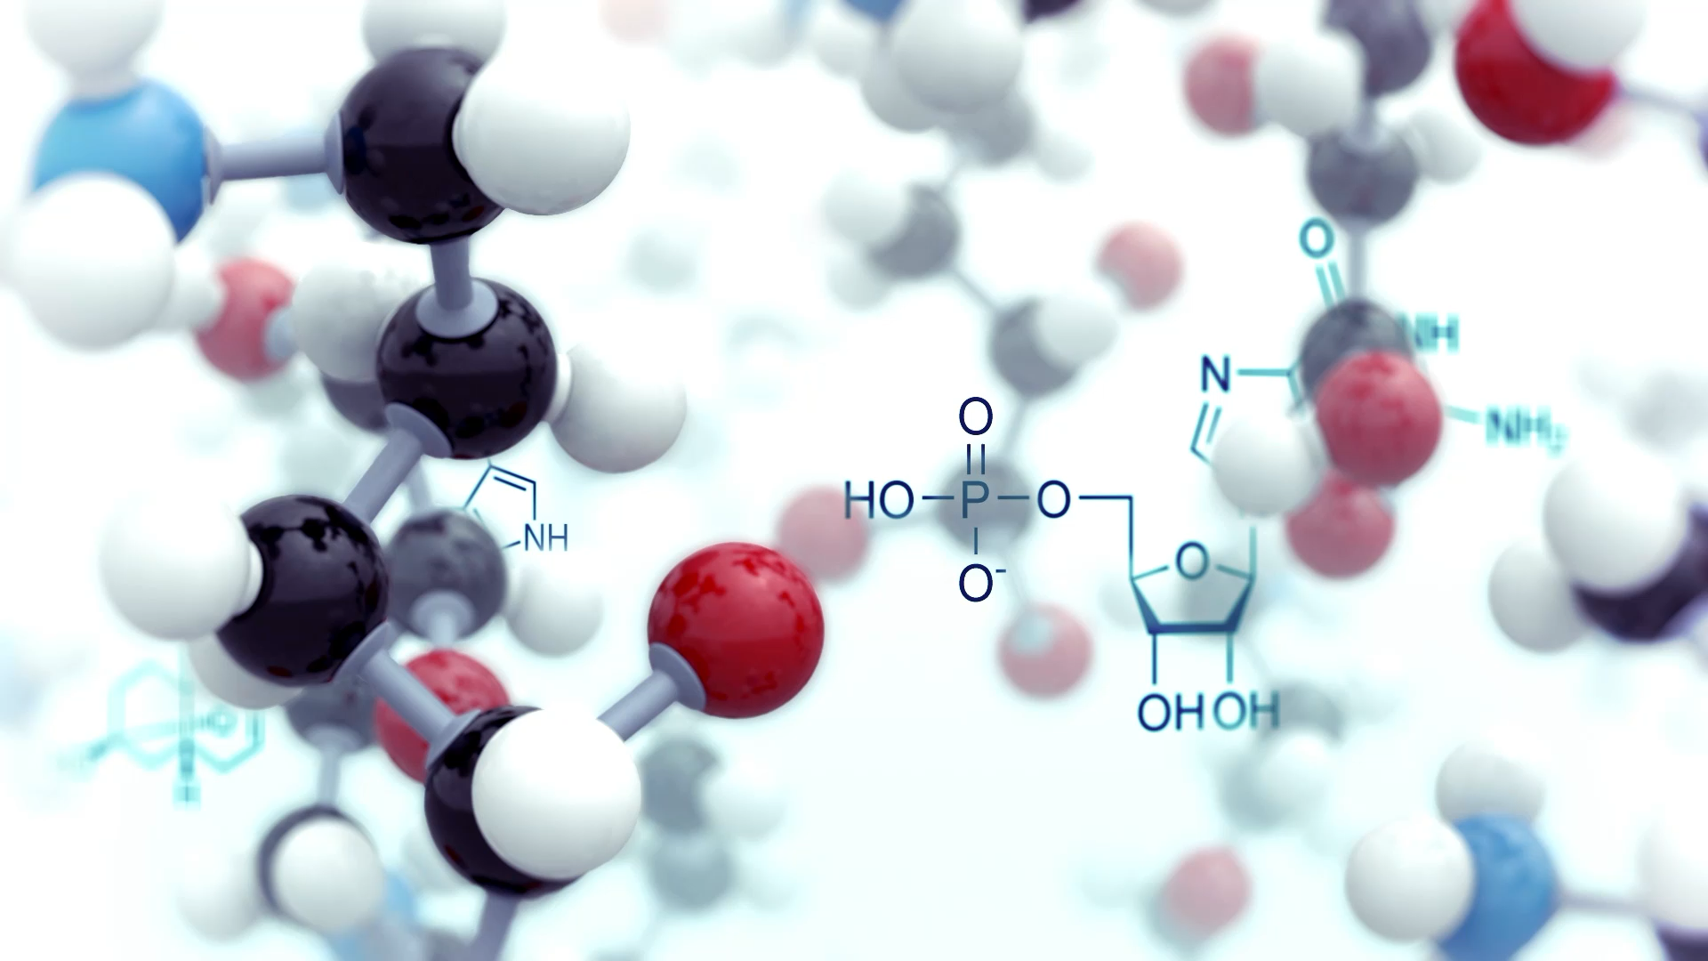
Sonification of Proteins for Analysis
Ananya Gupta and Suhanee Zaroo

Slide 2
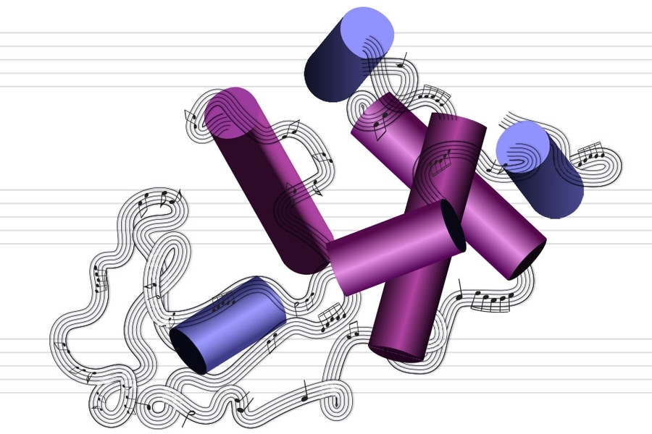
Index
Background
Hypothesis
Methods
Results
Conclusions

Slide 3
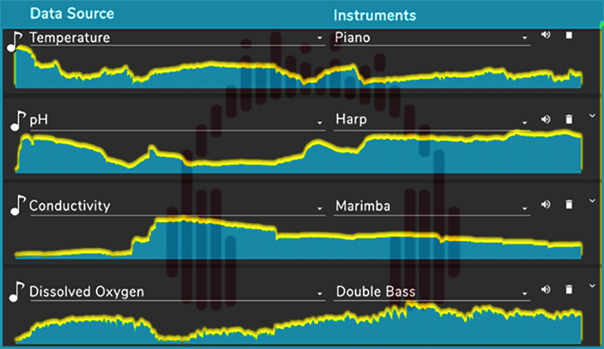
Data Sonification
A field that involves converting data to sound
Allows researchers and individuals to use their sense of hearing and basic music intuition to understand complex datasets
The sonification of water
Source: Pace University

Slide 4
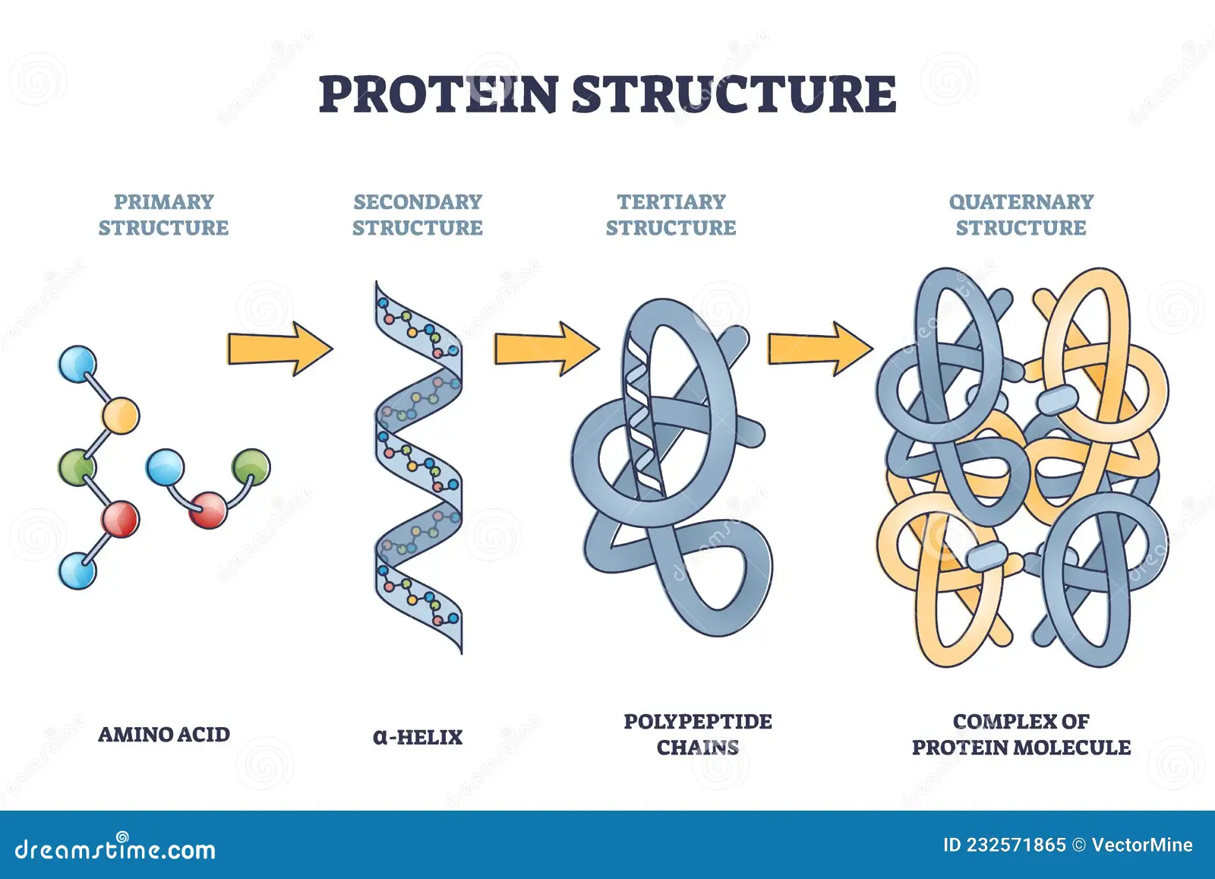
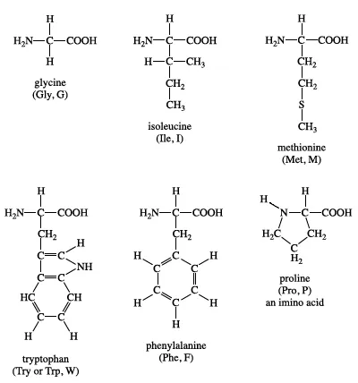
Protein structure
Biopolymer of amino acids, responsible for all important physiological processes in living organisms (enzyme action, movement of molecules, antibodies).
20 distinct amino acids, with different chemical structures and properties
Chemistry of amino acids determines the structure and function of the protein
Source: Britannica

Slide 5
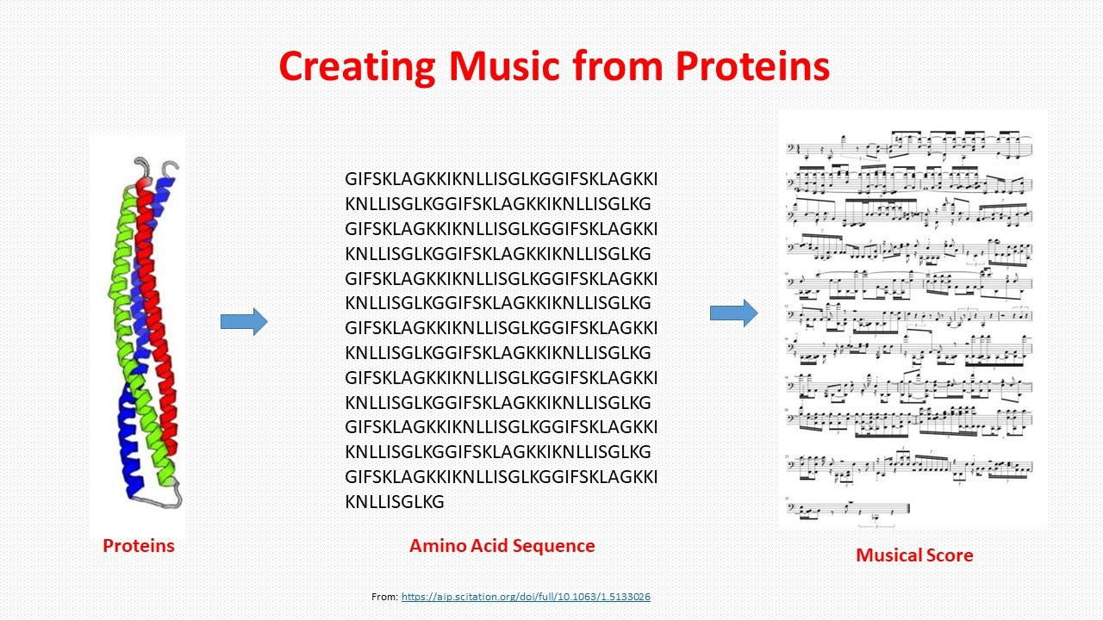
Protein Music
Mapping an amino acid to a specific musical note and playing it to hear the protein
First successful implementation in 1996
Artificial intelligence to study the music sequences that is generated.
Pioneered by Markus Buehler’s team at MIT
Source: Yu & Buehler 2020

Slide 6
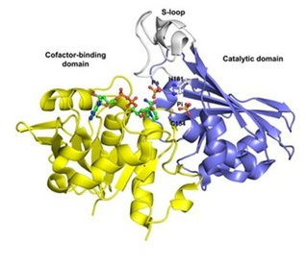
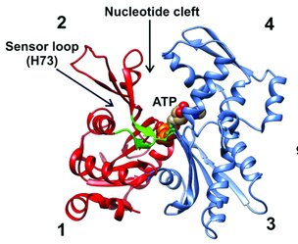
Hypothesis
Create a program that maps the protein sequence of human GAPDH and β-Actin to music
Notes assigned to each amino acid on the basis of the GES (Goldman, Engelman, and Steitz) hydrophobicity scale (Martin et al., 2021).
Compare auditory and visual methods of understanding protein sequence data using Hydrophilicity Plots(Hopp, T. P., & Woods, K. R. (1981))
GAPDH structure
Source: Zaffagnini et al., 2013
Β-actin structure
Source: Witecka et al., 2021

Slide 7
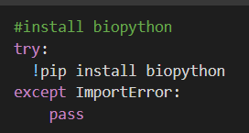
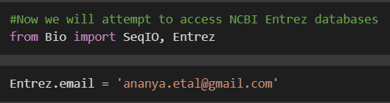
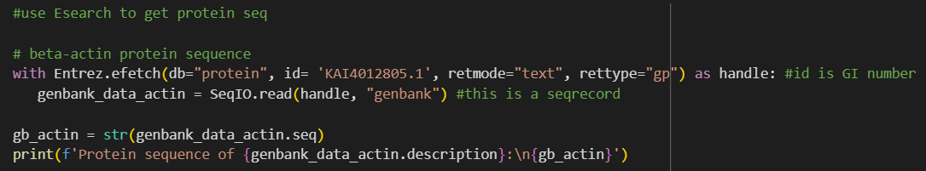
Extract Amino Acid Sequences
Used Biopython Library to access Entrez and extract sequences from unique GI numbers.

Slide 8
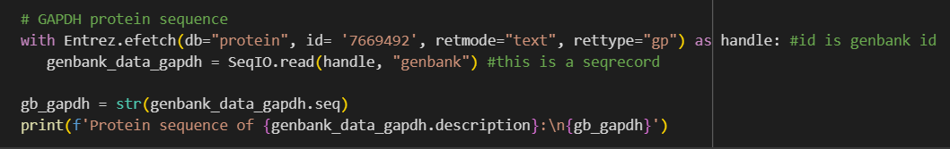
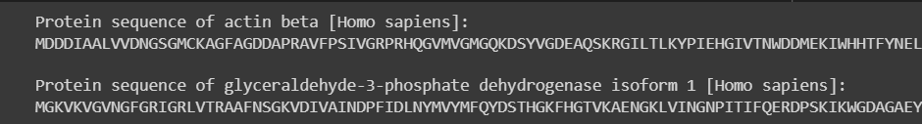
Biopython (Cont.)
Output

Slide 9
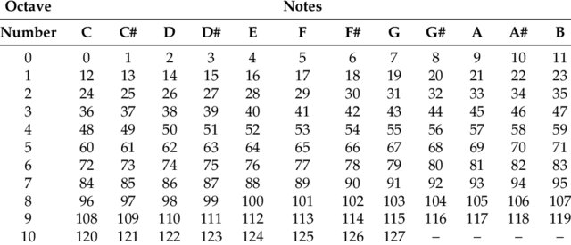
Musical mapping
Library used: music21
Amino acid residues ordered from most to least hydrophobic
Assigned a MIDI (Musical Instrument Digital Interface) number, which corresponds to a particular note and pitch.
Assigned the 20 amino acids between MIDI numbers 30-70 (step-2). The most hydrophobic amino acid (Phenylalanine, F) was assigned 30 (low pitch), and so on.
MIDI values
Source: Nicholson & Kim, 2016

Slide 10
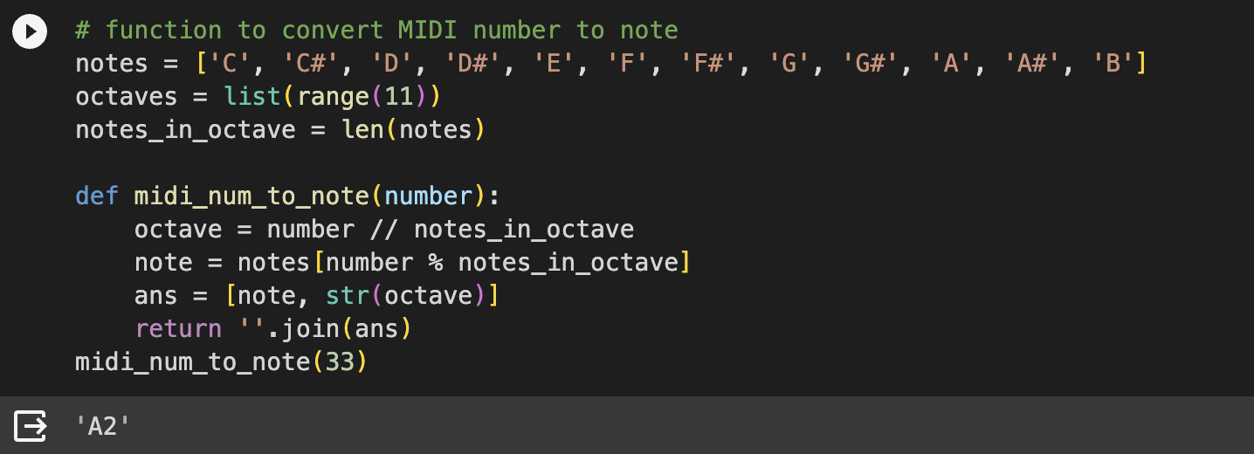
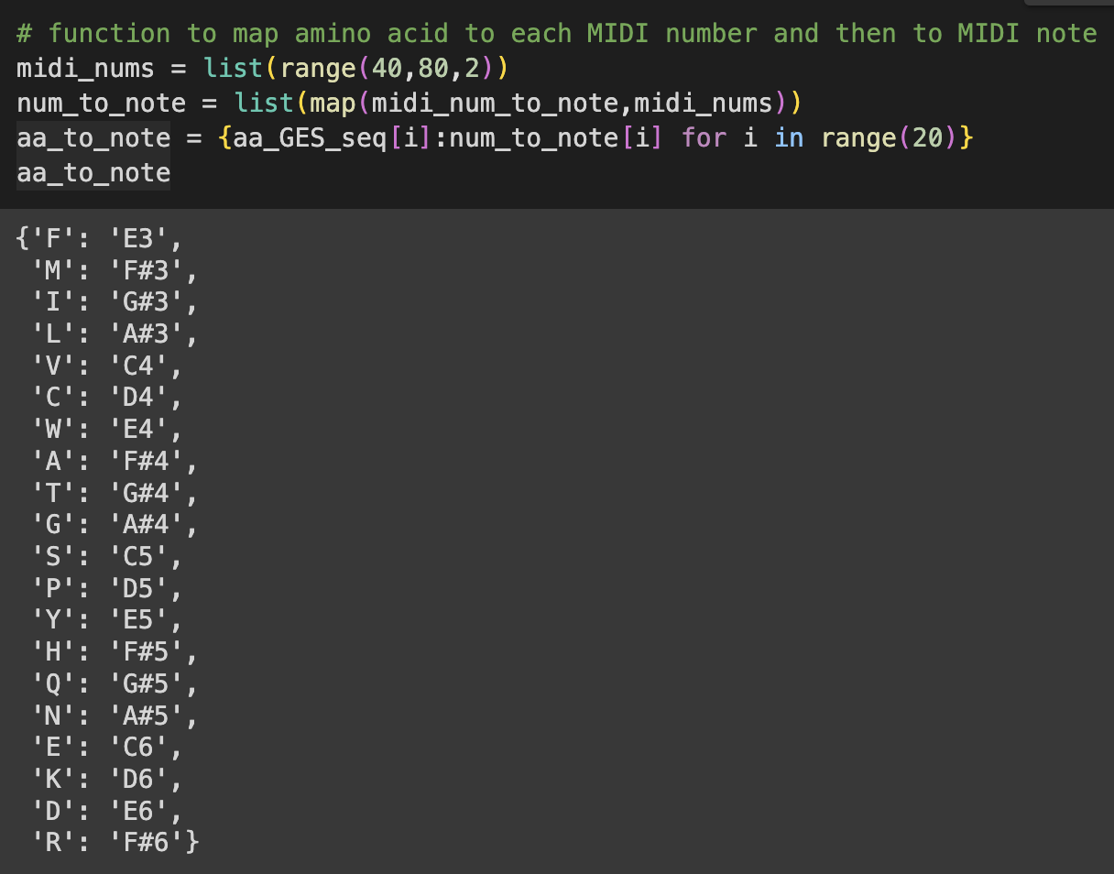
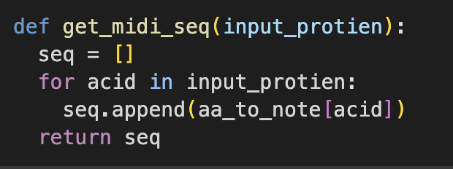
Musical Mapping
Defined a function to convert MIDI number to note
Made a dictionary, assigning each amino acid to a MIDI note, which was mapped and converted from the assigned MIDI number
Defined a function to obtain the note sequence from amino acid sequence
Original idea: Dev Aggarwal, 2018 (GitHub)
https://gist.github.com/devxpy/063968e0a2ef9b6db0bd6af8079dad2a

Slide 11

Musical Mapping
Made a list with attributes (tempo and duration) assigned from the music21 library and appended the notes obtained.
Streamed the file on Colab
Wrote and downloaded the MIDI file, and opened with GarageBand to modify it further
GarageBand Logo

Slide 12
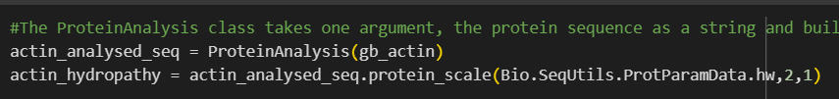
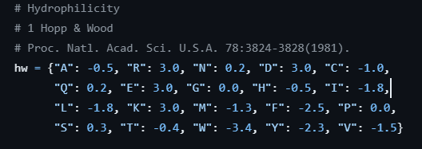
Graphing
ProteinAnalysis method was used to create Sequence Objects from protein sequence strings
The protein_scale(Scale, WindowSize, Edge) was used to create plot points using Hopp and Woods hydrophilicity scale. (Higher numbers to hydrophilic residues)
Static graphs were made using MatplotLib Library. Real time graphs made with FuncAnimation from matplotlib.animation

Slide 13
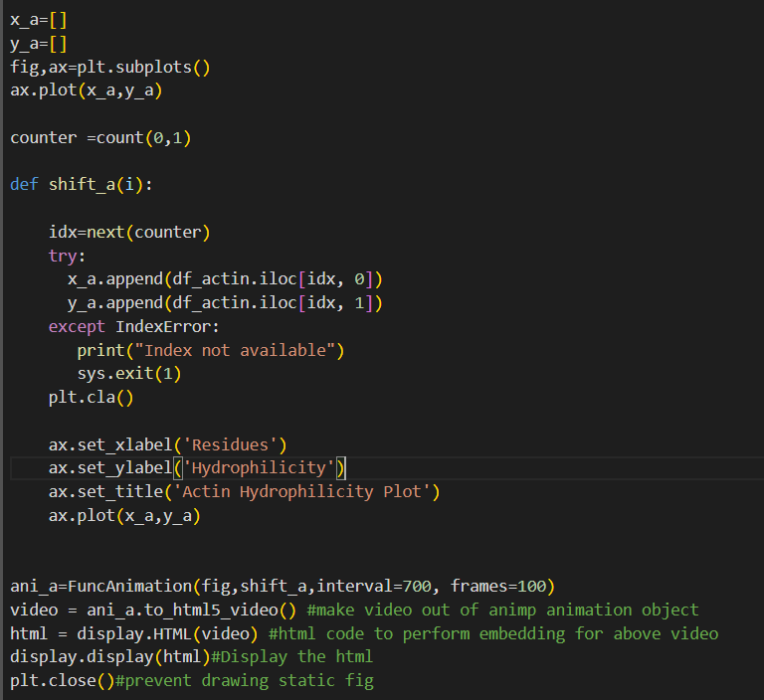
Graphing (Cont.)
For Real-time Plots, plotting information was saved in a dataframe
Unique functions to be passed as arguments in FuncAnimation function were made to plot every value
The plot was generated in python using HTML display
Ref: Updating Function

Slide 14
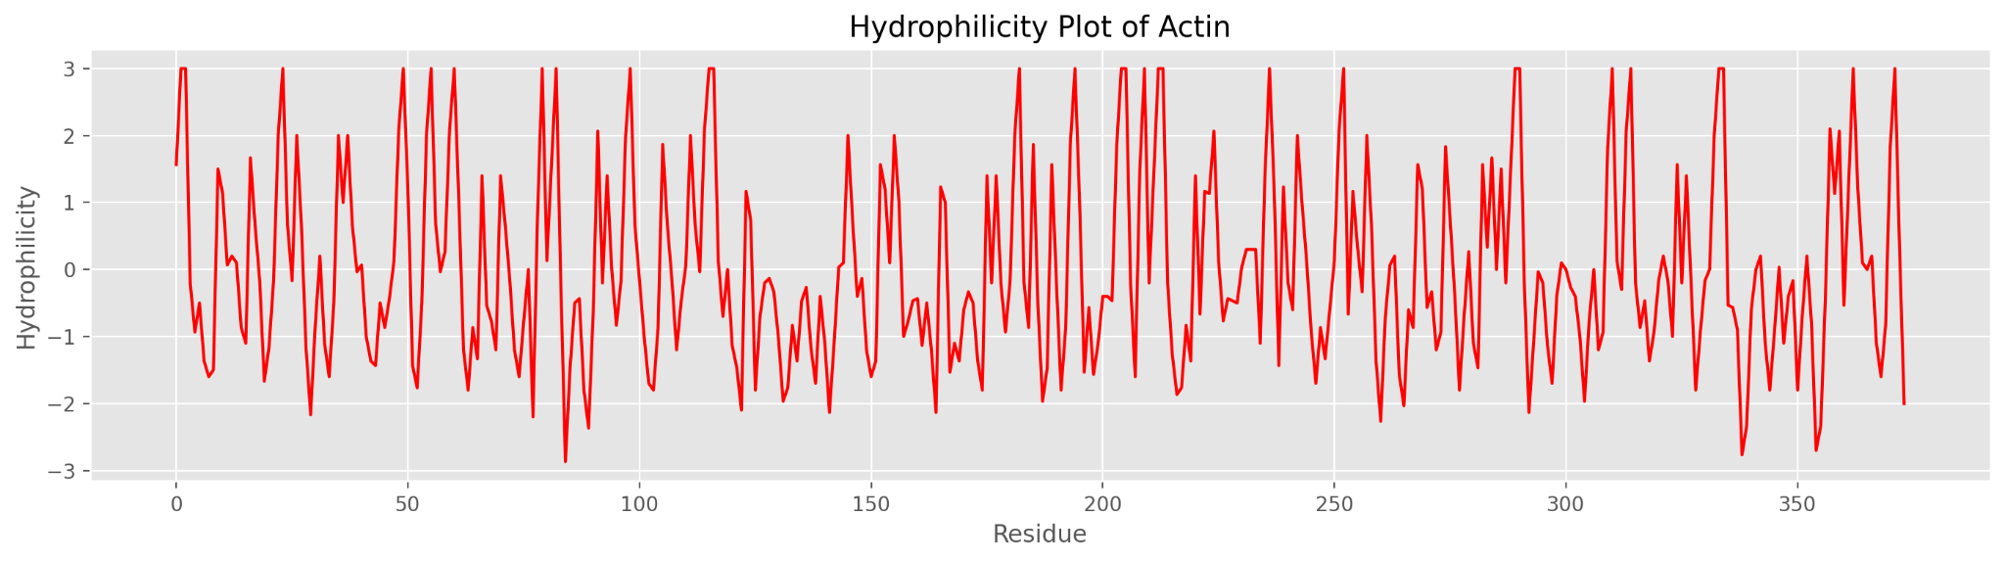
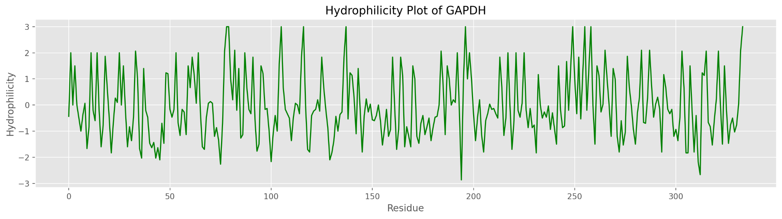
Static Graphs

Slide 15
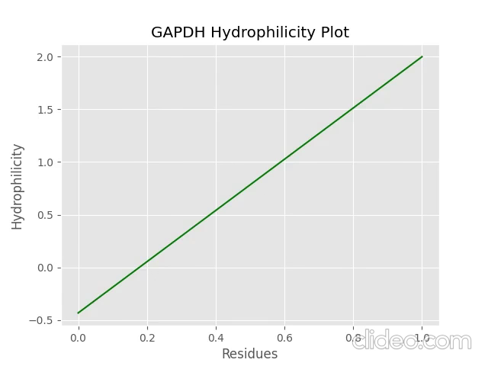

Results - GAPDH
Music File
Graph compared with Music

Slide 16
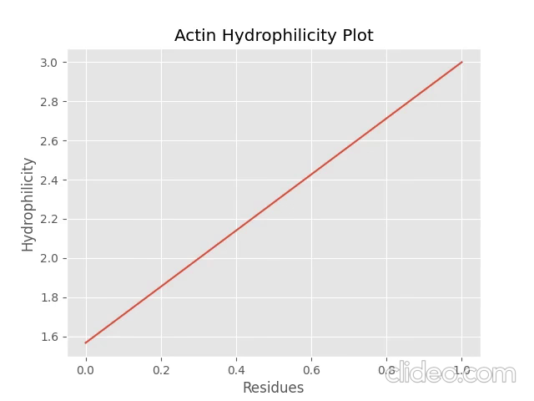
Results - Actin
Music File
Graph compared with Music

Slide 17
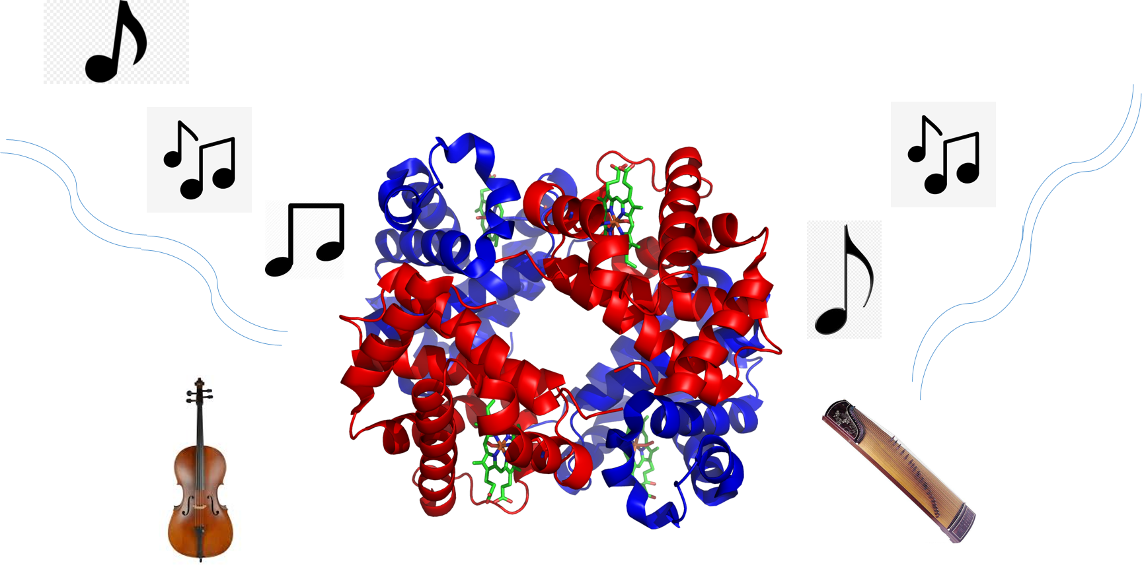
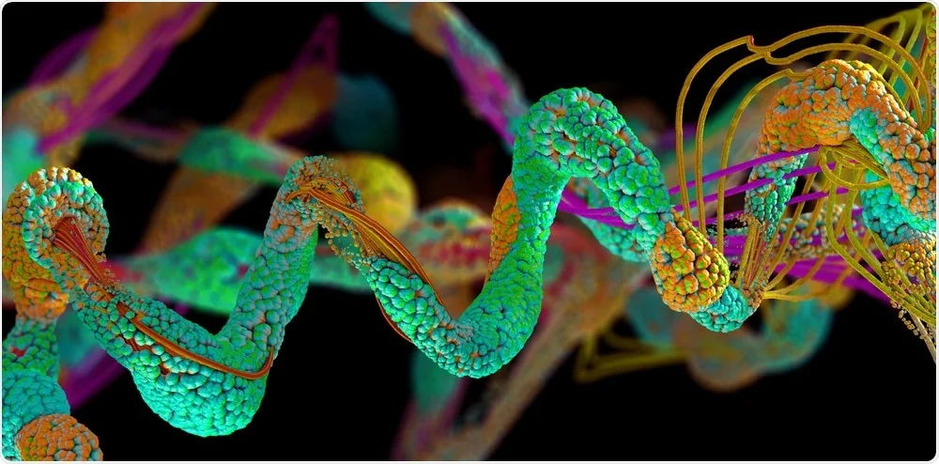
Conclusions
From music file: Low pitch sounds correspond to hydrophobic residues, which are present in the inner portion of the protein structure.
Auditory information aids in understanding more about
Future work: mapping proteins on different criteria (ex: size of residues, folded structure of the protein.

